Slide 1
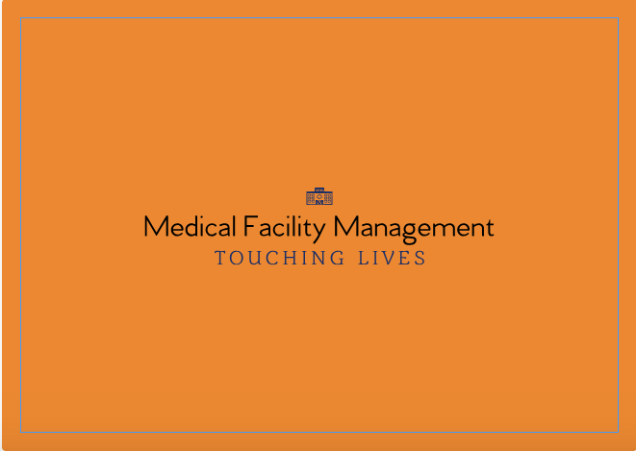
Team: code chefs
Team members: Nikhitha, harshitha, apurva

Slide 2
Content
Problem Statement
Approach
Object Model
Use Case
Screenshots

Slide 3
Problem statement
In the developing world , we are still facing the issue of being unable to deliver the medical items like vaccines , medicines on time.This causes many people their lives.It would be a major issue in remote areas.
If the medical products are not available at a particular supplier/distributor,the higher authorities should be given incharge of providing the amenities.
There is no proper procedure available for collecting the people’s requirement and ordering them and redirecting the requests to the concerned authority.

Slide 4
APPROACH
Medical Facilities Management System is a Java Swing project developed to overcome the problem of the inability to deliver the medical equipment, medicines and blood to remote locations due to lack of supply chain infrastructure.
This project not only would help to provide an optimum solution to improve the efficiency but would also help the hospital get access to medical facilities on an urgent basis.
This application would provide an end to end solution to the problem of storing medical supplies to delivering it to the concerned patient or hospital.

Slide 5
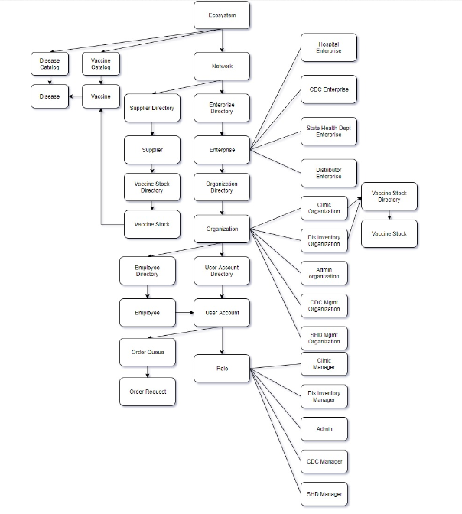

Slide 6
Use cases
Raising requests of necessary medicines by doctors to CDC
Tracking medical requests and monitoring status.
Adding charts so that admins can make future decisions by analysis.
The application would process the doctor request as emergency or basic need.

Slide 7
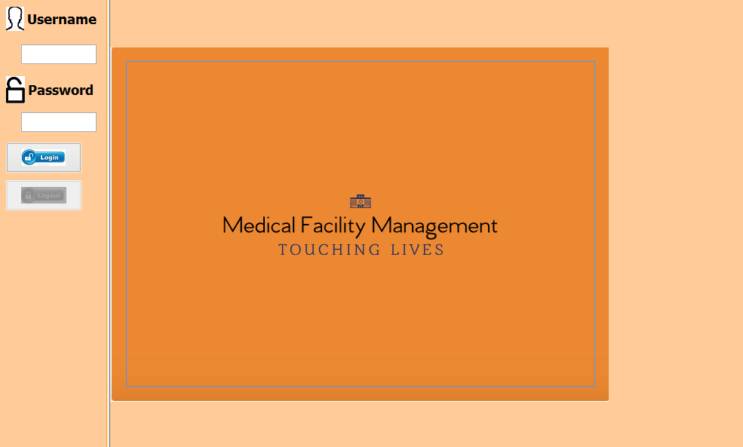
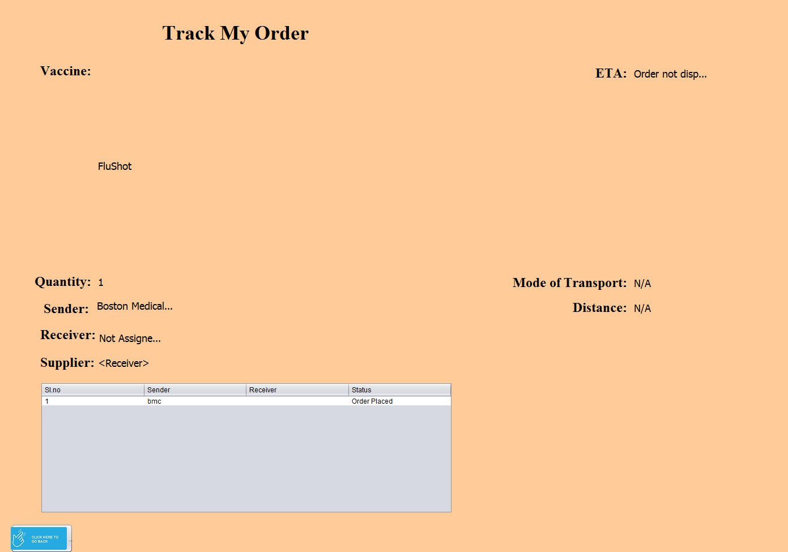

Slide 8
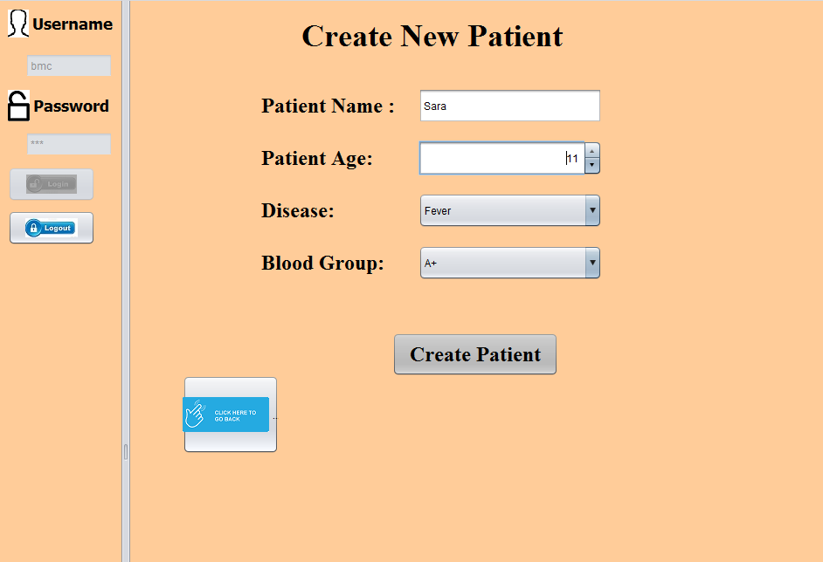
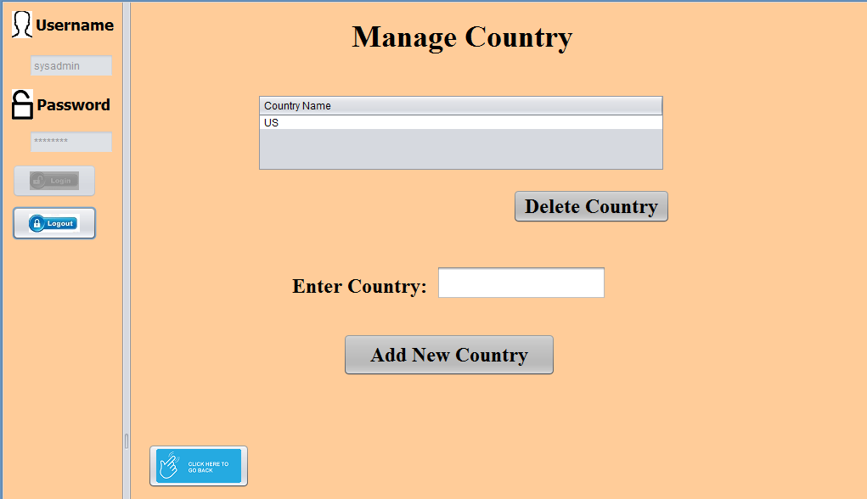

Slide 9
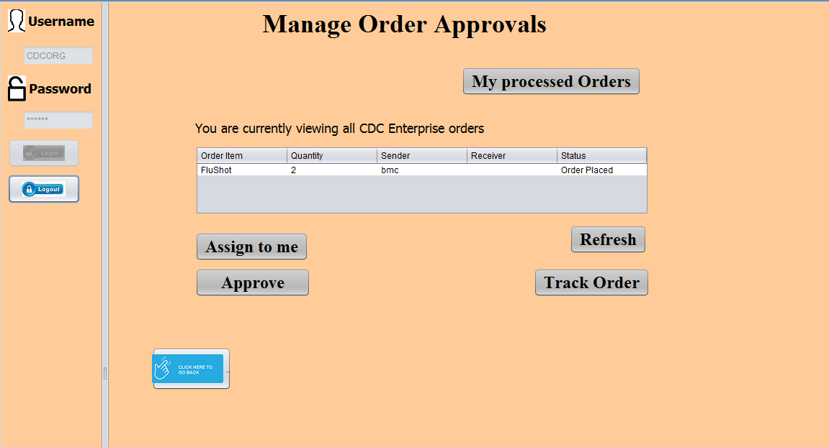
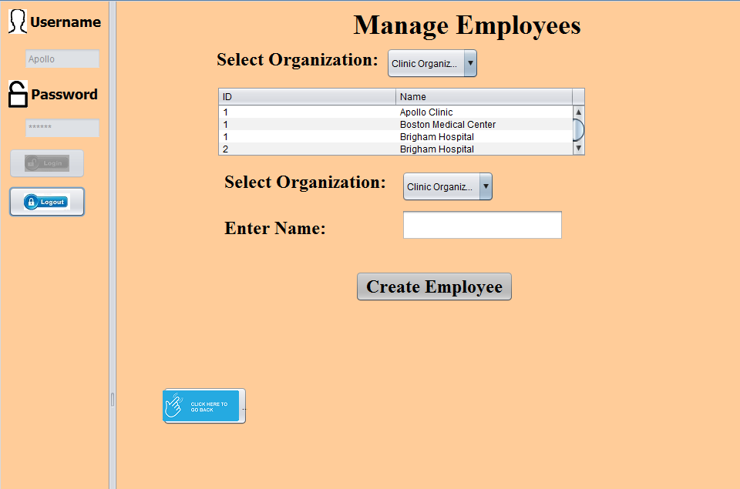

Slide 10
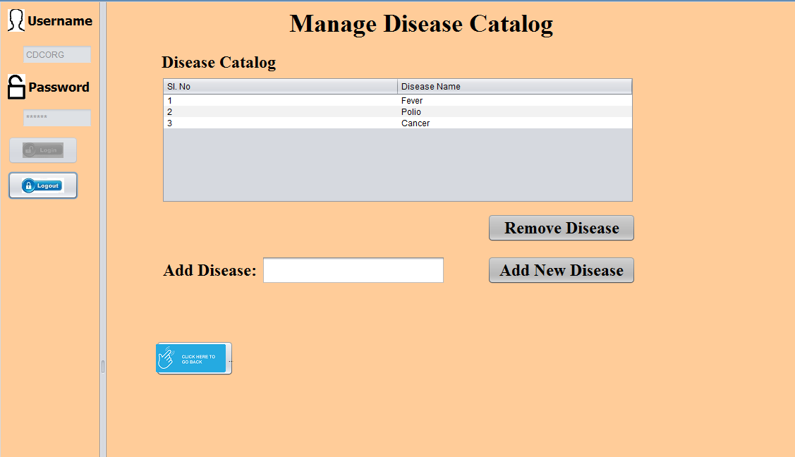
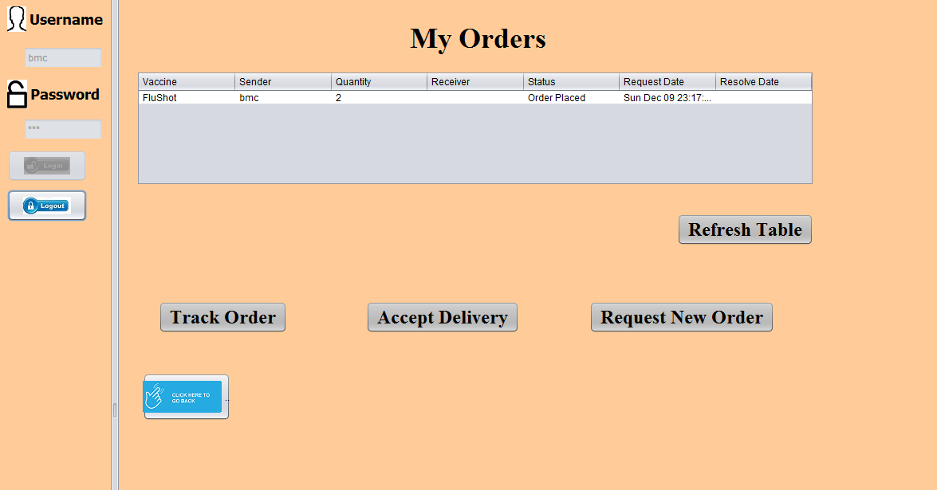

Slide 11
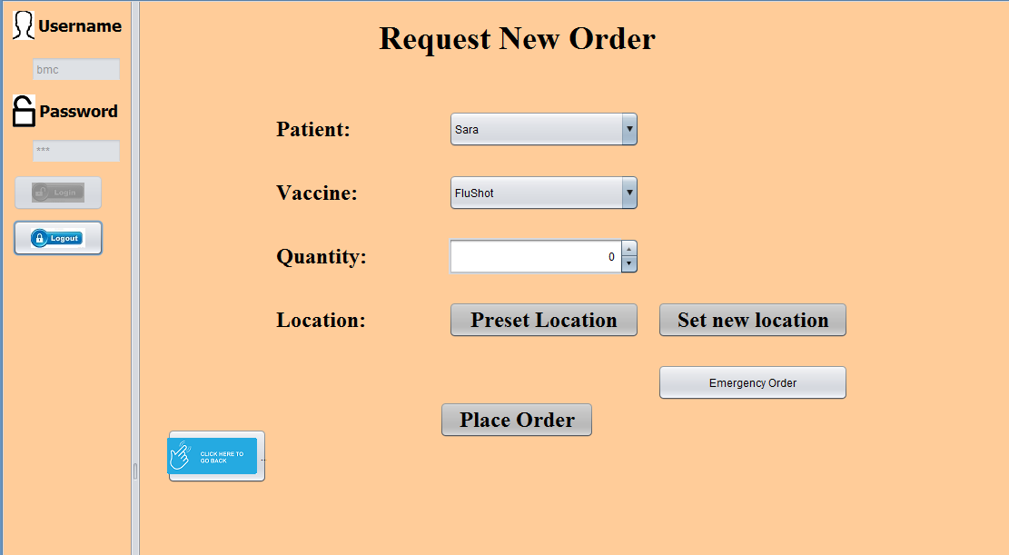

Slide 12
THANK YOU

